Slide 1
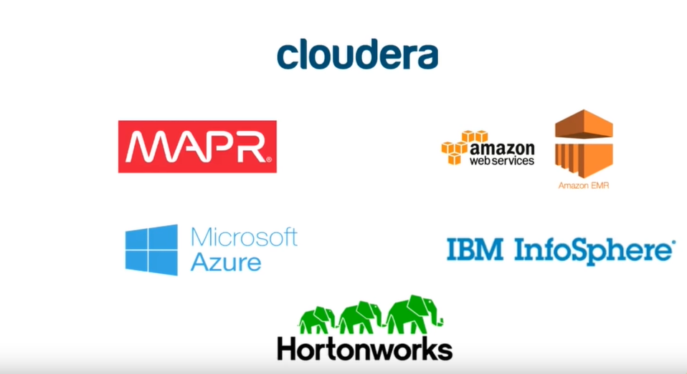
What are the different vendor specific distributions of Hadoop ?

Slide 2
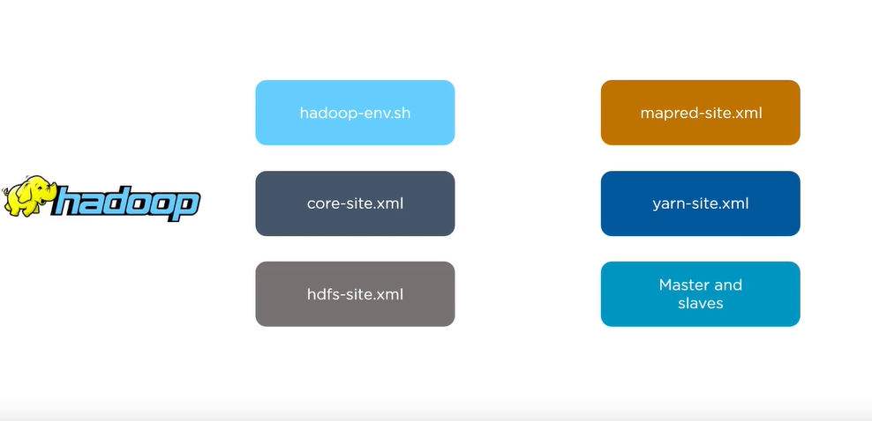
What are the different Hadoop configuration files ?

Slide 3
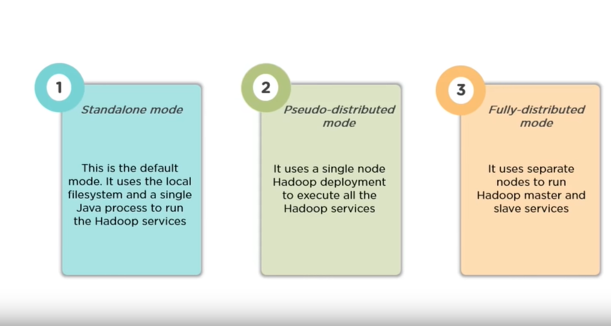
What are the 3 modes in Which Hadoop can run ?

Slide 4
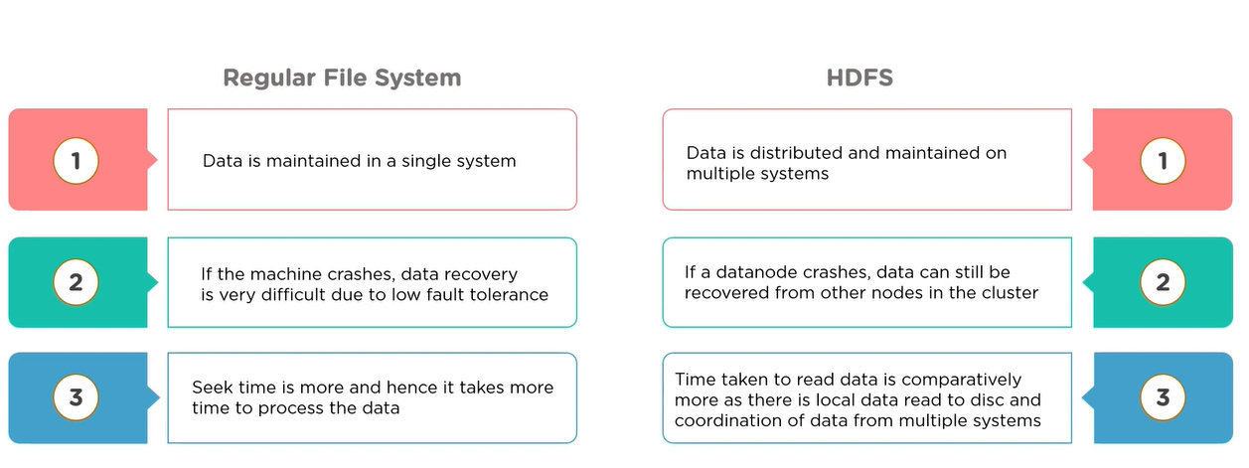
What are the differences between regular file system and HDFS ?

Slide 5
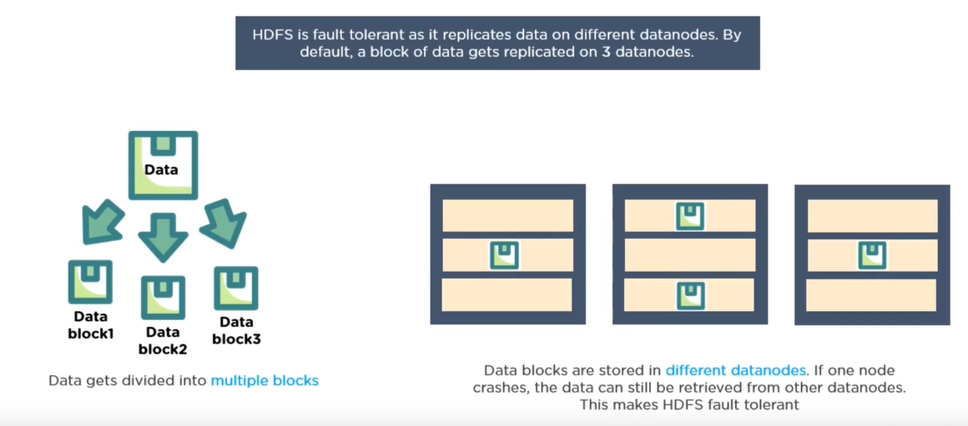
Why is HDFS fault tolerant ?

Slide 6
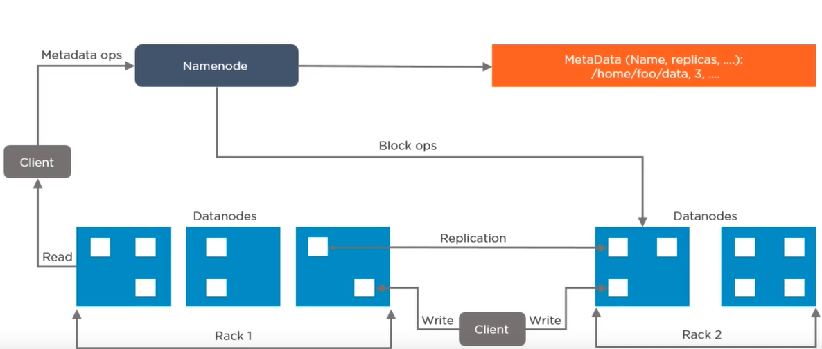
A-Explain the architecture of HDFS.

Slide 7
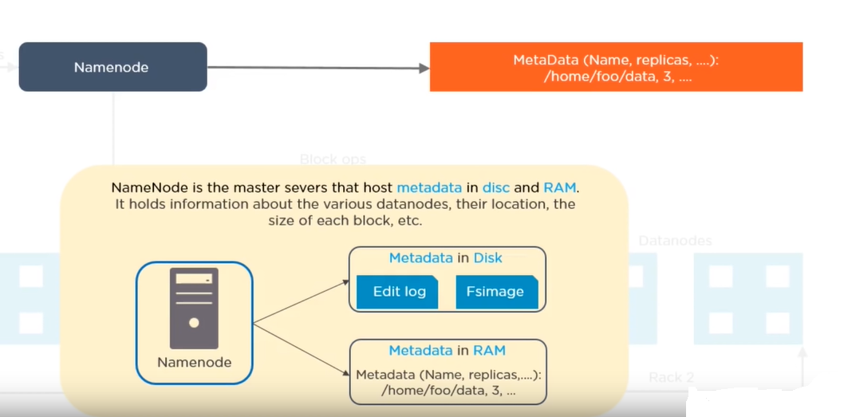
B-Explain the architecture of HDFS.

Slide 8
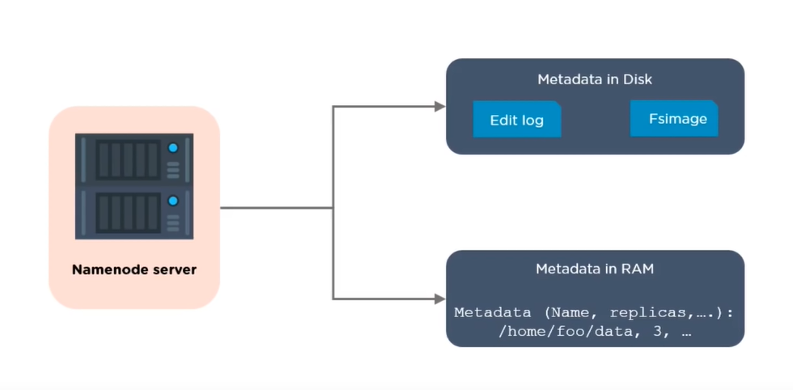
What are the 2 types of metadata a Namenode server holds?

Slide 9
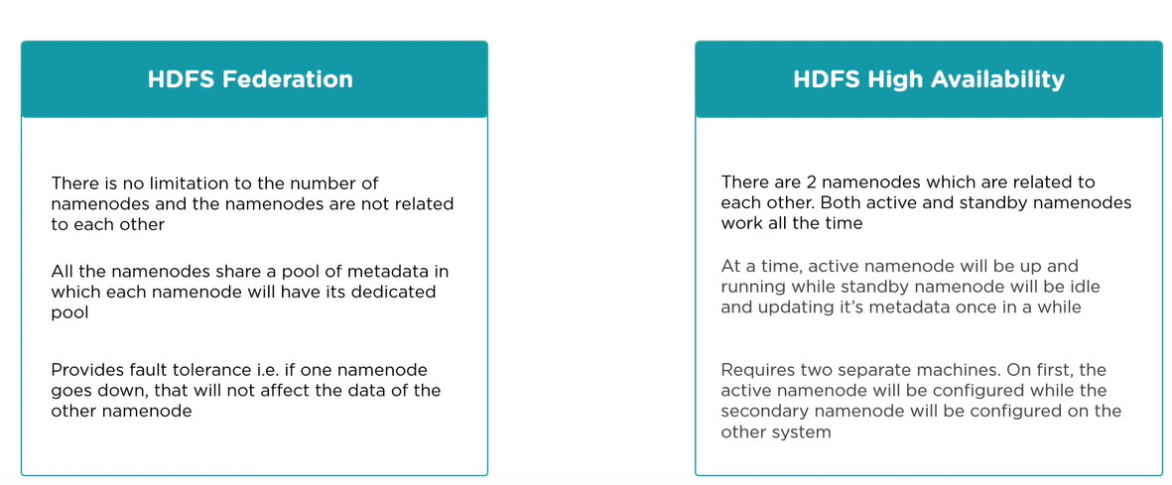
What is difference between federation and high availability?

Slide 10
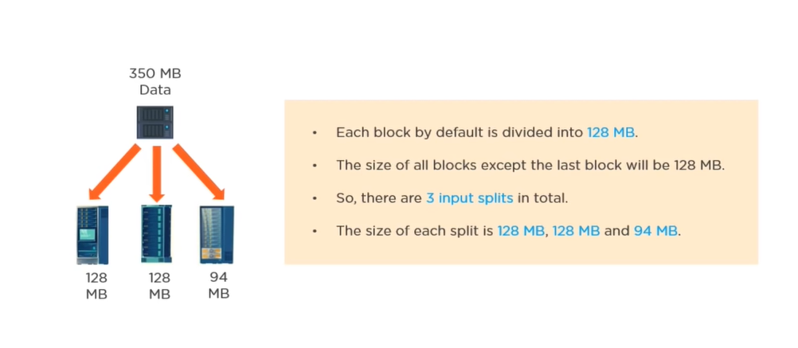
If you have an input file of 350 MB, how many input splits will be created by HDFS an what is the size of each input split?

Slide 11
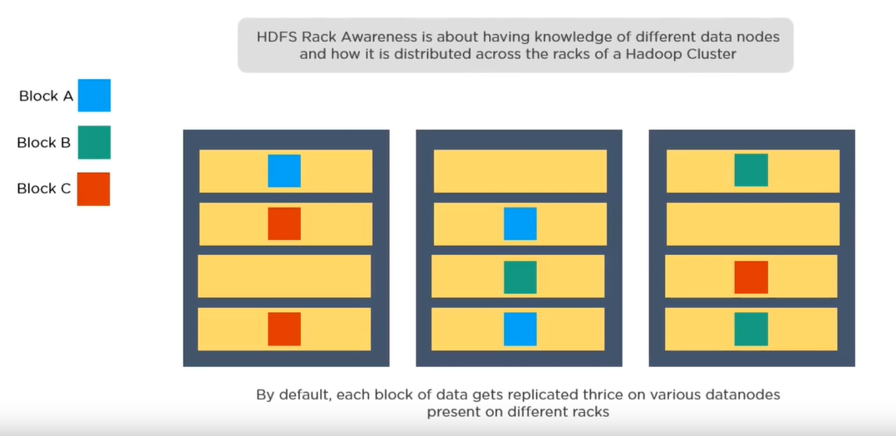
How does rack awareness work in HDFS?

Slide 12
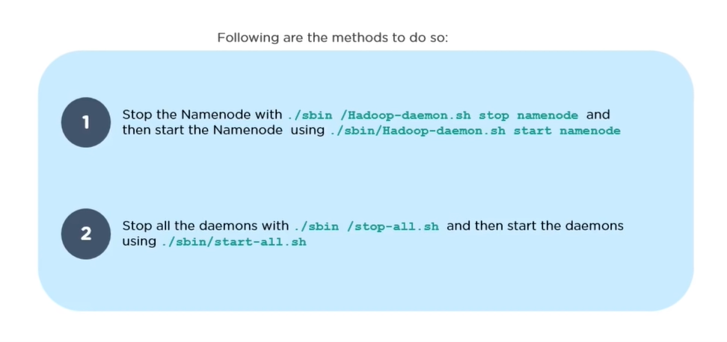
How can you restart Namenode and all the daemons in Hadoop?

Slide 13
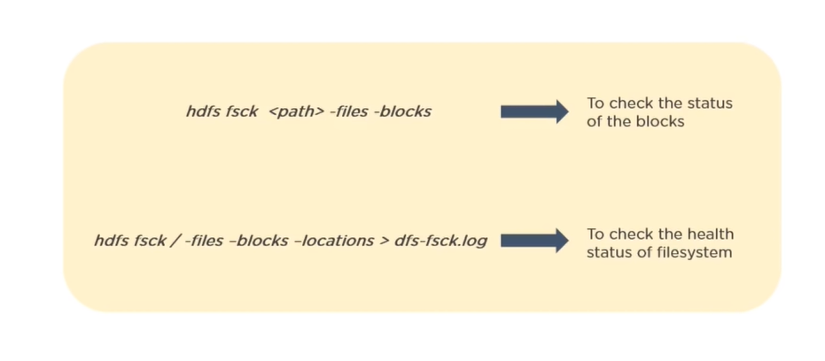
Which command will help you find the status of blocks and filesystem health?

Slide 14
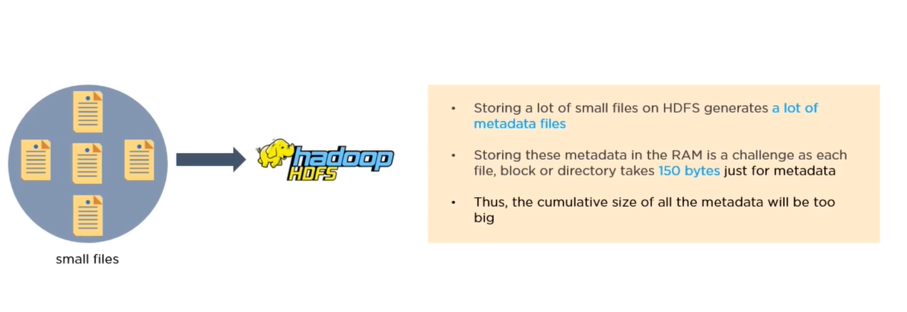
What would happen if you store too many small files in a cluster on HDFS?

Slide 15
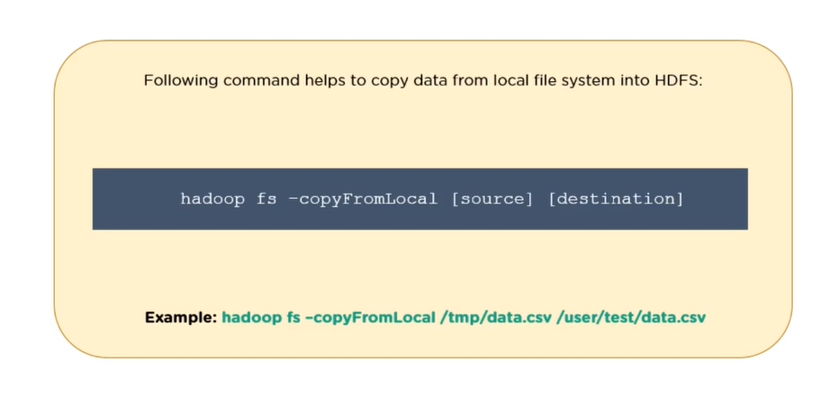
How to copy data from local system on to HDFS?

Slide 16
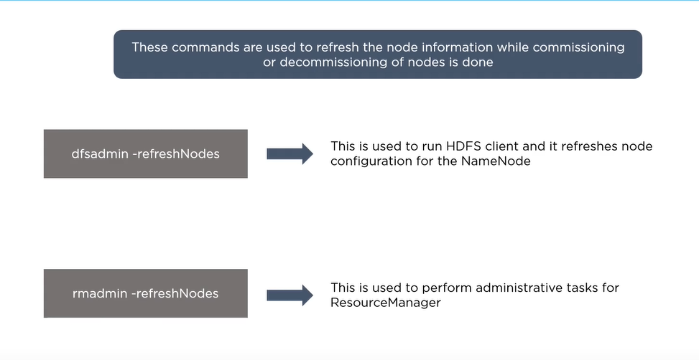
When do you use dfsadmin –refreshNodes and rmadmin –refreshNodes command?

Slide 17
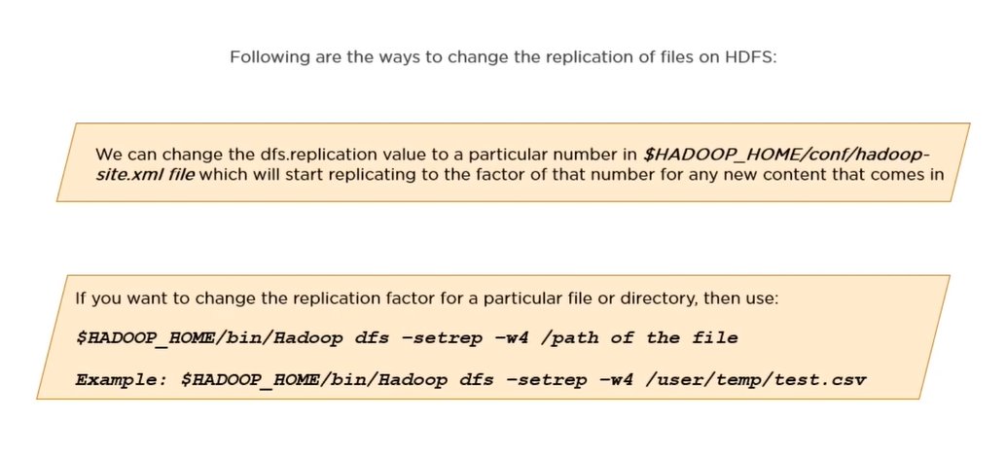
Is there anyway to change replication of files on HDFS after they are already written to HDFS?

Slide 18
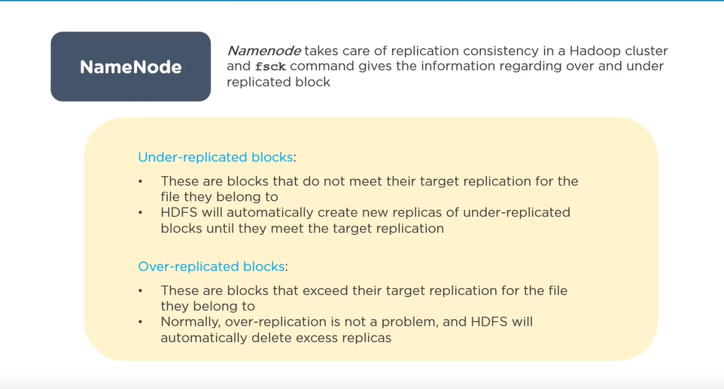
Who takes care of replication consistency in a Hadoop cluster and What do you mean by under/over replicated blocks?

Slide 19
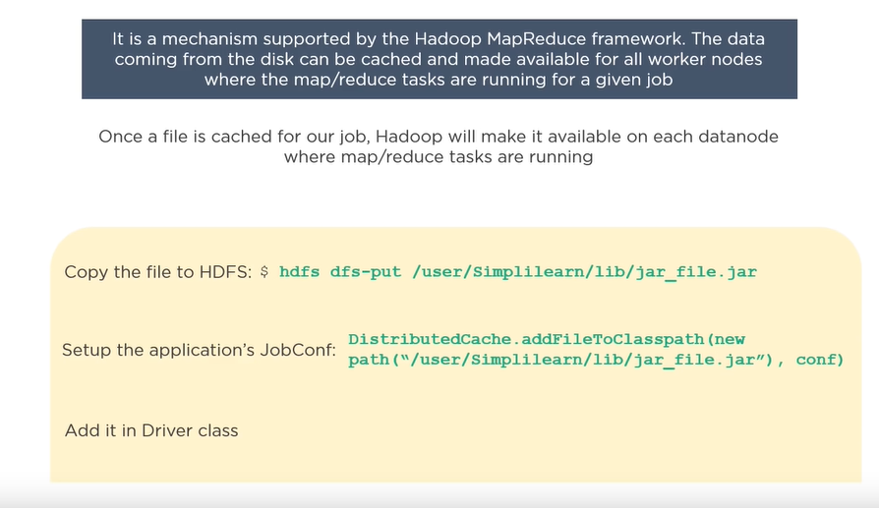
What is distributed cache in MapReduce?

Slide 20
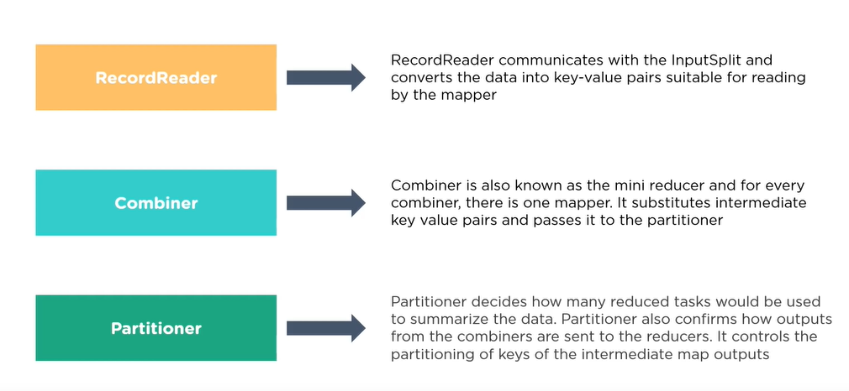
What role do RecordReader, Combiner and Partitioner play in a MapReduce operation?

Slide 21
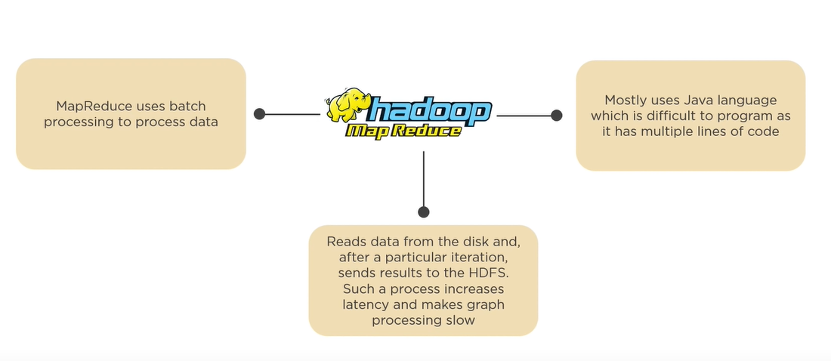
Why is MapReduce slower in processing data in comparision to other processing framework?

Slide 22
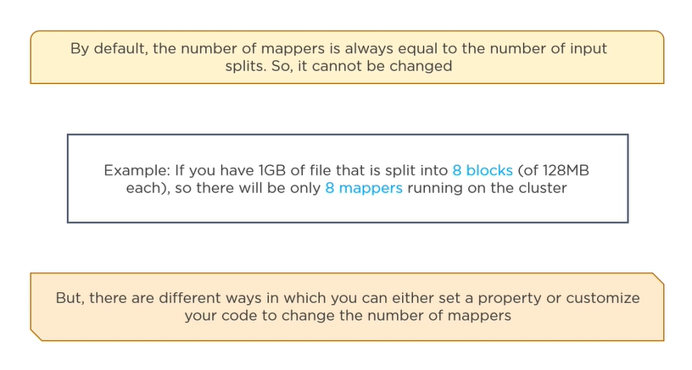
For a MapReduce job, is it possible to change the number if mappers to be created?

Slide 23
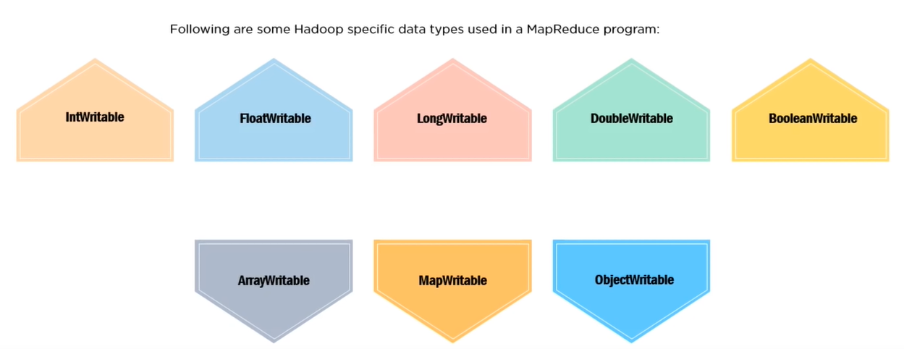
Name some Hadoop specific data types that are used in a MapReduce program

Slide 24
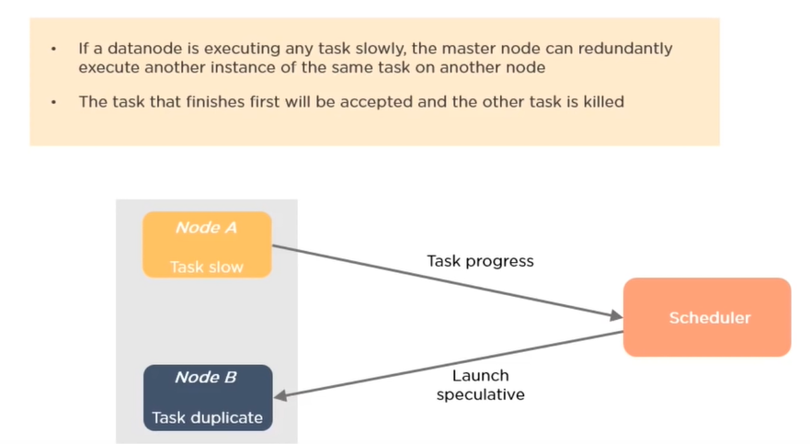
What is speculative execution in Hadoop?

Slide 25
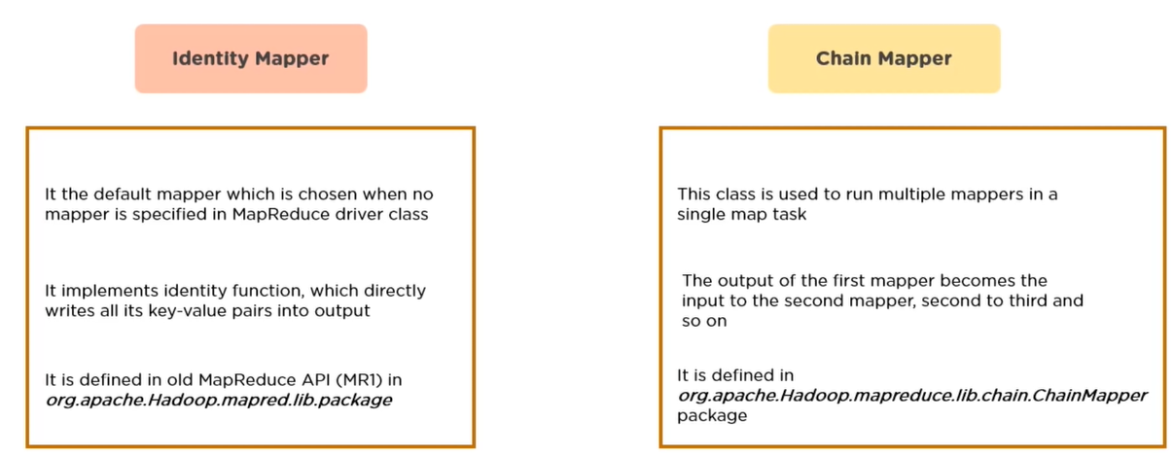
How is identity mapper different from chain mapper?

Slide 26
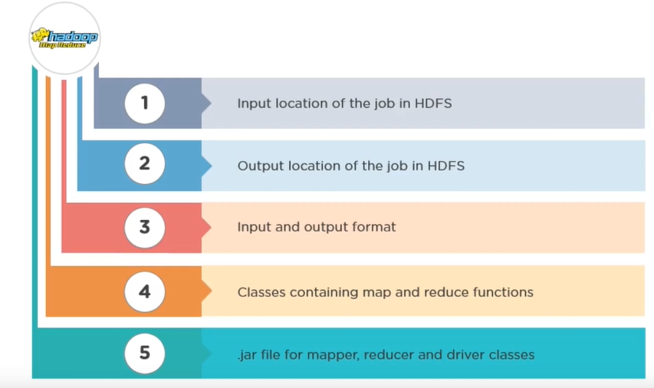
What are the major configuration parameters required in a MapReduce program?

Slide 27
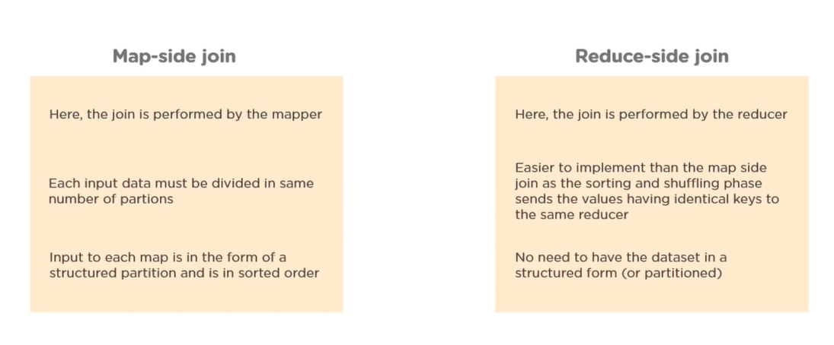
What do you mean by map-side join and reduce-side join in MapReduce?

Slide 28
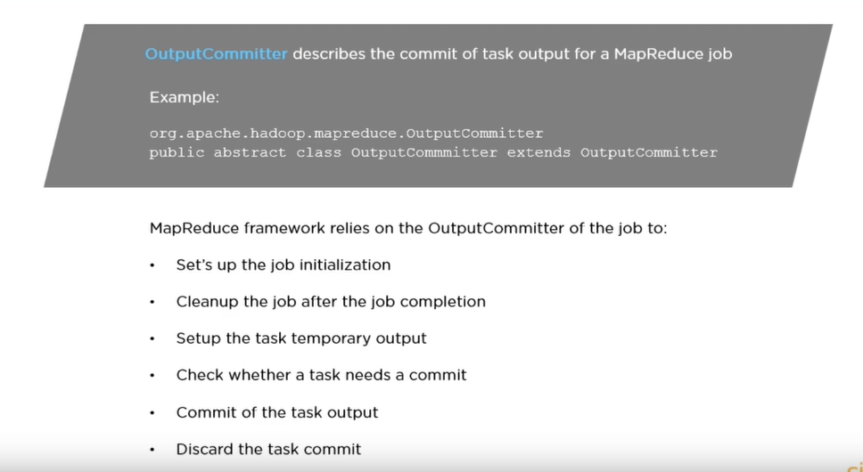
What is the rule of OutputCommitter class in a MapReduce job?

Slide 29
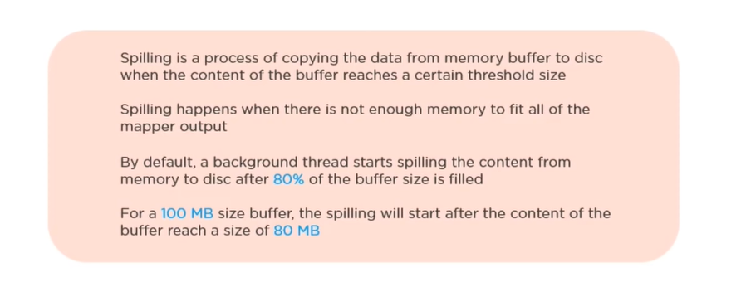
Explain the process of spilling in MapReduce

Slide 30
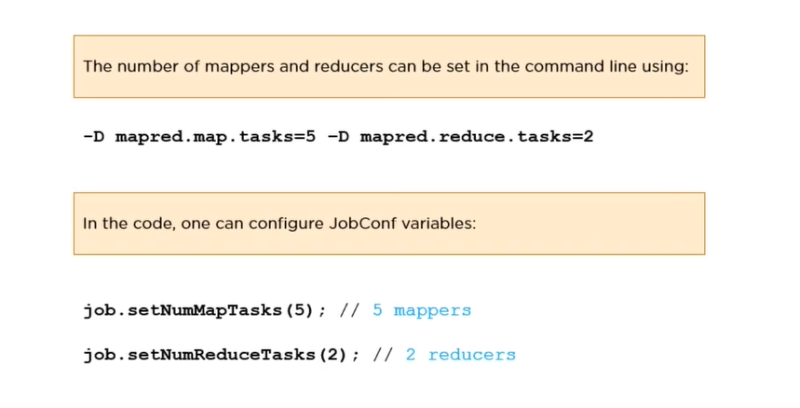
How can you set the mappers and reducers for a MapReduce job?

Slide 31
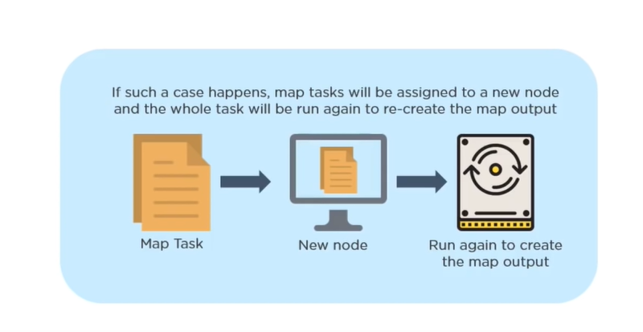
What happens when a node running a map task fails before sending the output to the reducer?

Slide 32
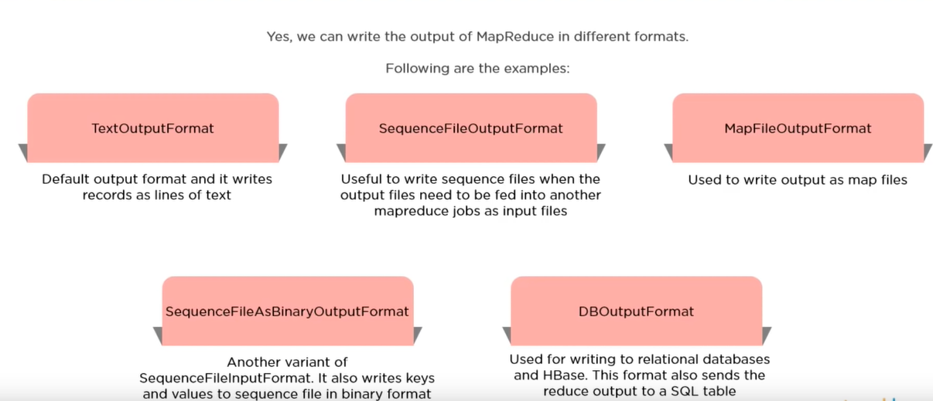
Can we write the output of MapReduce in different formats?

Slide 33
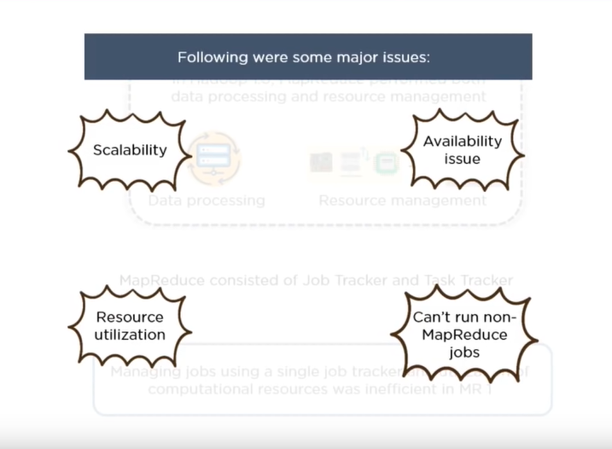
What benefits did YARN bring in Hadoop 2.0 and how did it solve the issues of MapReduce V1?

Slide 34
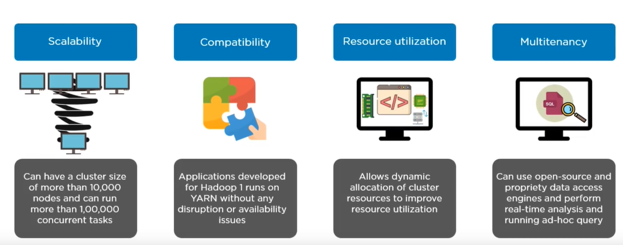
What benefits did YARN bring in Hadoop 2.0 and how did it solve the issues of MapReduce V1?

Slide 35
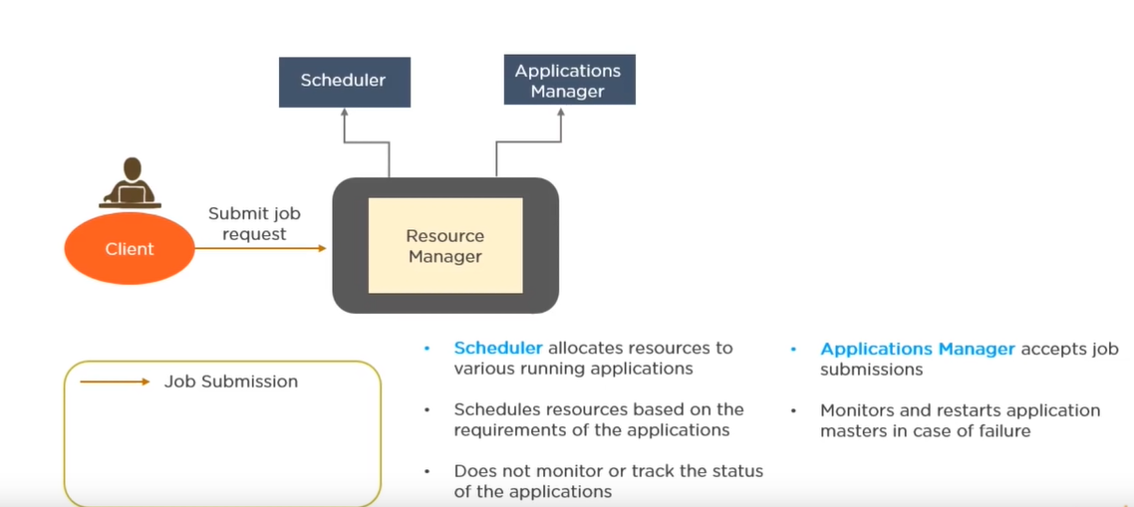
A-Explain how YARN allocates resources to an application with the help of its architecture

Slide 36
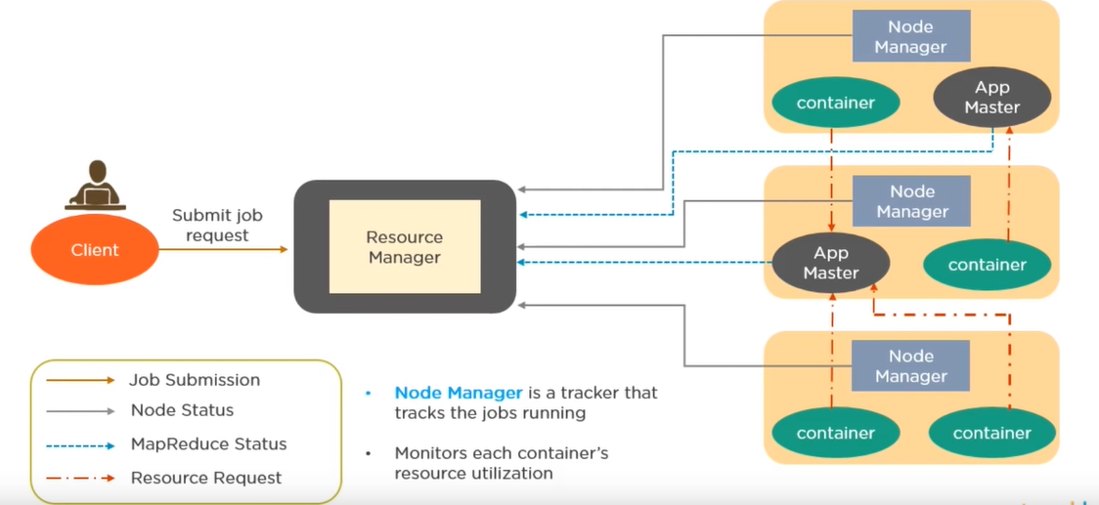
B-Explain how YARN allocates resources to an application with the help of its architecture

Slide 37
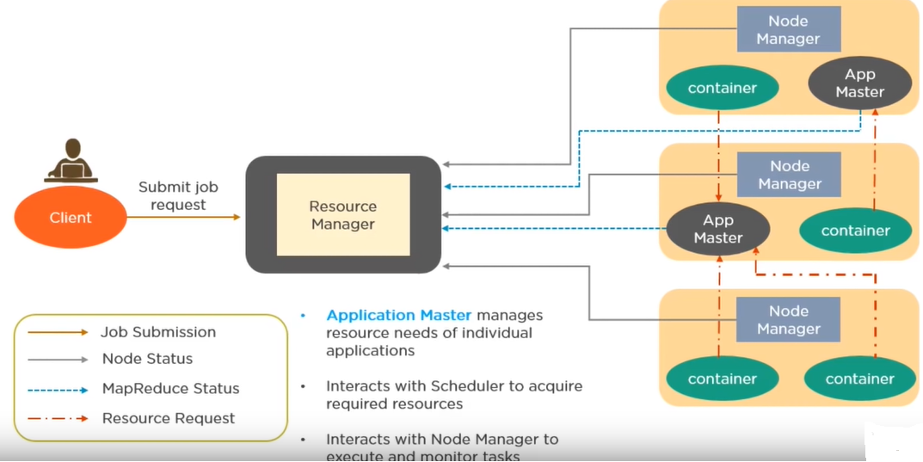
C-Explain how YARN allocates resources to an application with the help of its architecture

Slide 38
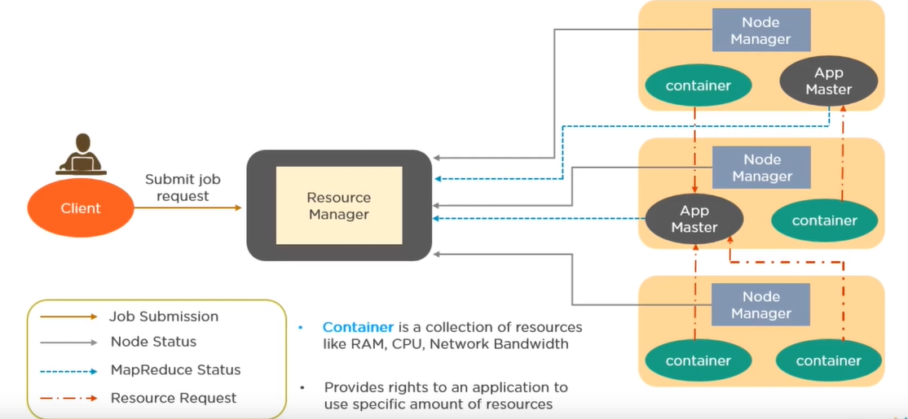
D-Explain how YARN allocates resources to an application with the help of its architecture

Slide 39
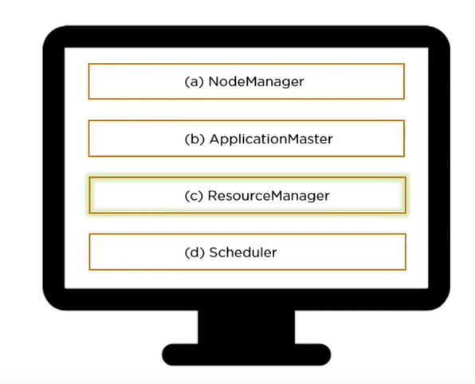
Which of the following has occupied the place of job Tracker of MapReduce V1?

Slide 40
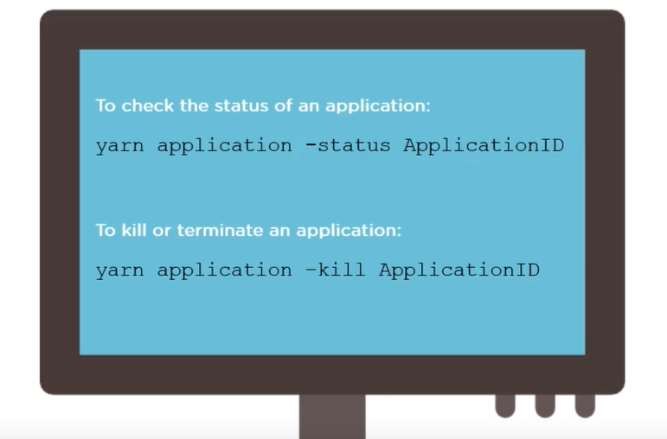
Write the YARN command to check the status of an application and kill an application

Slide 41
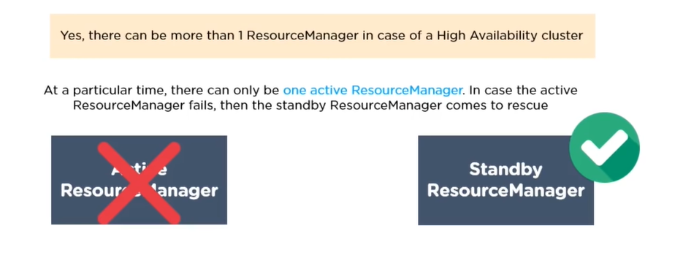
Can we have more than 1 resourceManager in a YARN based cluster?

Slide 42
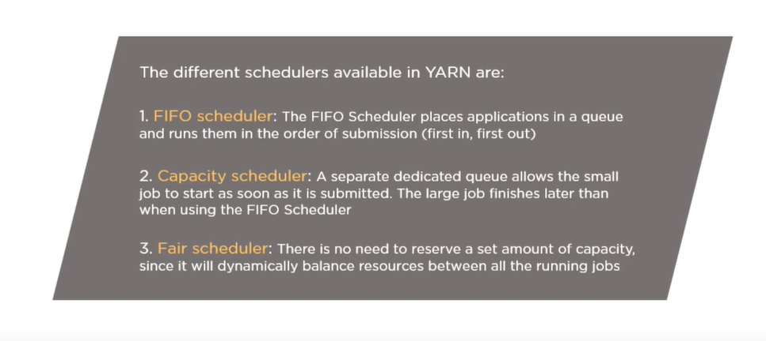
What are the different schedulers available in YARN?

Slide 43
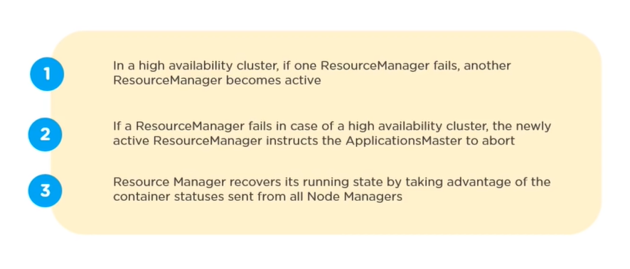
What happens if a ResourceManager fails while executing an application in a high availability cluster?

Slide 44
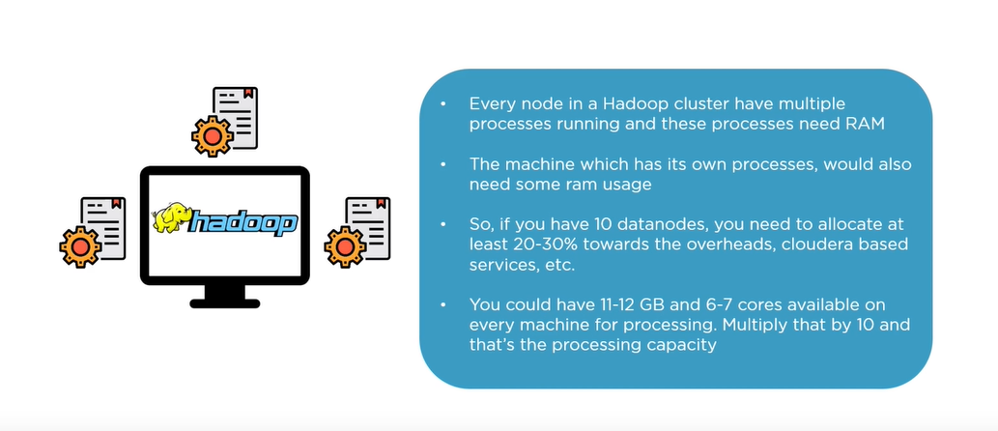
In a cluster of 10 datanodes, each having 16GB RAM and 10 cores, What would be the total processing capacity of the cluster?

Slide 45
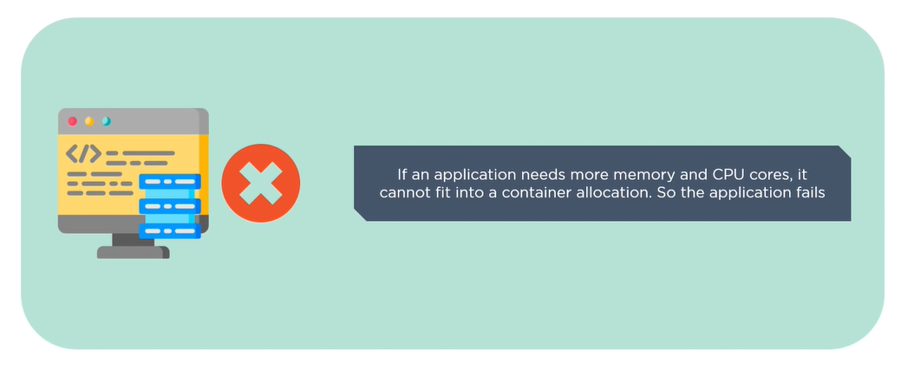
What happens if requested memory or CPU cores goes beyond the size of container allocation?

Slide 46
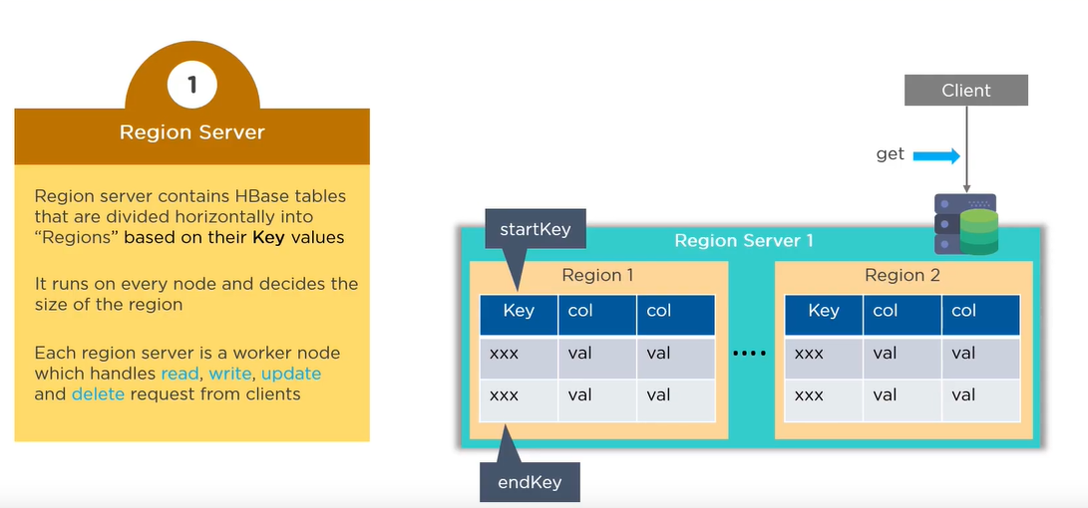
A-What are the key components of Hbase?

Slide 47
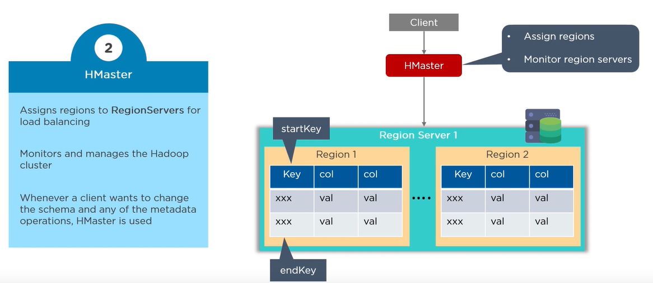
B-What are the key components of Hbase?

Slide 48
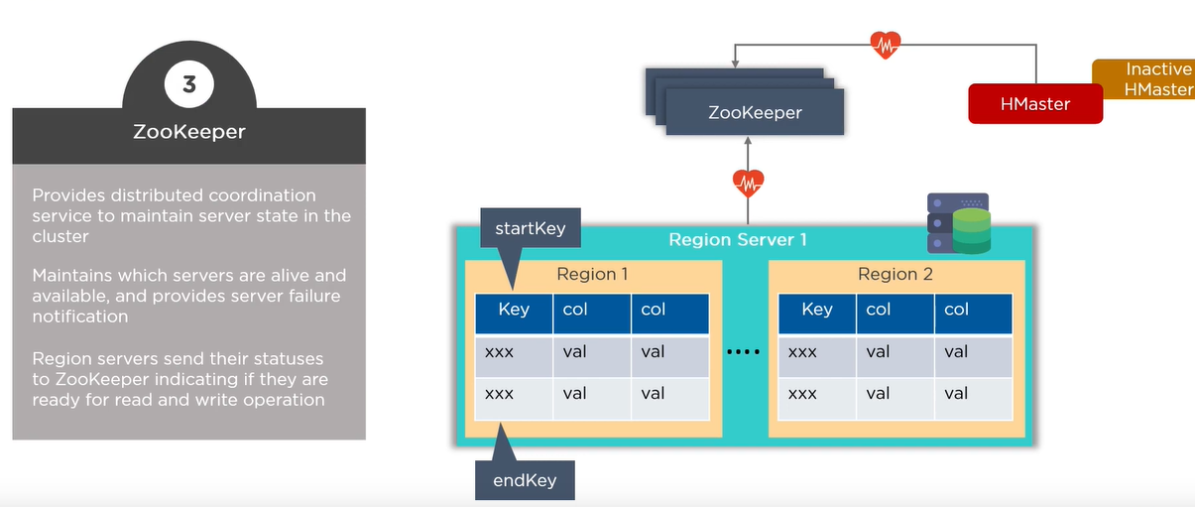
C-What are the key components of Hbase?

Slide 49
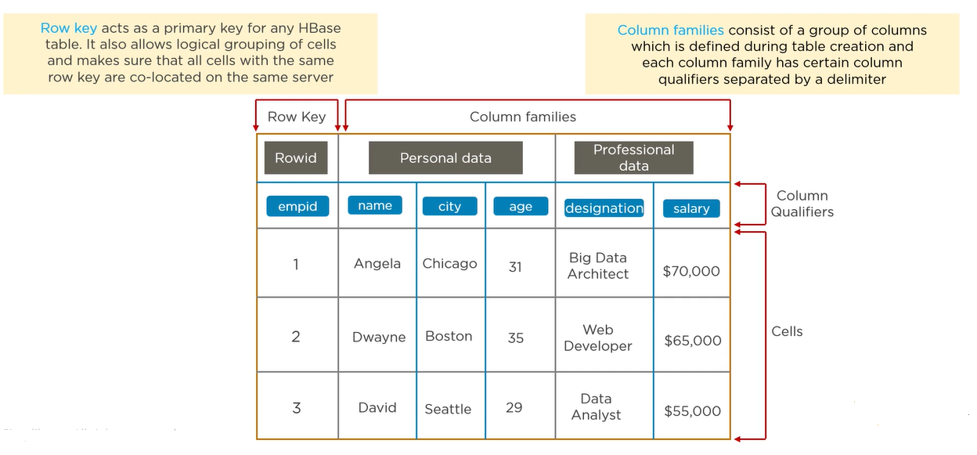
Explain What are row key and column families in Hbase?

Slide 50
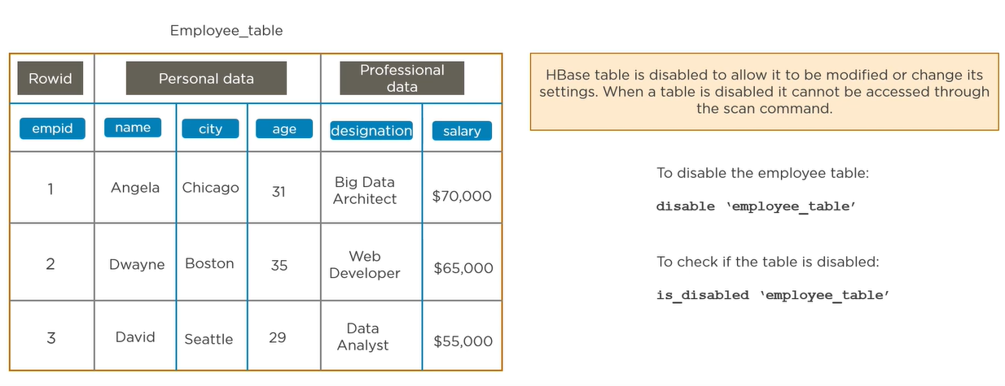
Why do we need to disable a table in Hbase and How do you do it?

Slide 51

Write the code to open a connection in Hbase.

Slide 52

What does replication mean in terms of Hbase?

Slide 53

Can we do an import/export in Hbase table?

Slide 54

What do you mean by compaction in Hbase?

Slide 55

How does bloom filter work?

Slide 56

Does Hbase have any concept on namespace.

Slide 57

How does write ahead log (WAL) help when a regionServer crashes?

Slide 58

Write the Hbase command to list the contents and update the column families of a table.

Slide 59

What are catalog tables in Hbase?

Slide 60

What is Hotspotting in Hbase and How to avoid Hotspotting?

